Slide 1
Project Title : Secure Data Hiding in image using steganographygraphy
CAPSTONE PROJECT
Student Name : Himanshu Kardam
College Name & Department : Galgotia College of Engineering and Technology & B.tech In Computer Science and Engineering

Slide 2
OUTLINE
Problem Statement
Technology used
Wow factor
End users
Result
Conclusion
Git-hub Link
Future scope

Slide 3
Problem Statement
This project aims to develop a steganography-based system that can securely embed and extract confidential messages from images while maintaining the integrity of the original file. Additionally, the system can integrate AES encryption to enhance security, making it an effective approach for covert communication.

Slide 4
Technology used
Technology | Purpose
Python | Core language for implementation
Pillow (PIL) | Image handling (load, edit, save)
OpenCV | Advanced image processing (optional)
NumPy | Pixel data manipulation
PyCryptodome | AES encryption for message security
Tkinter | GUI for user-friendly interaction
Matplotlib | Visualization of image changes (optional)
VS Code | Code editor for development

Slide 5
Wow factors
This project goes beyond basic steganography by incorporating encryption, error detection, GUI, and speed optimization, making it a robust and practical cybersecurity tool.
Advanced Security with AES Encryption
Minimal Image Distortion
User-Friendly GUI
Steganography with Error Detection

Slide 6
End users
Cybersecurity Professionals
Journalists & Whistleblowers
Intelligence & Military Organizations
Corporate & Business Users
General Users (Privacy-Conscious People
Healthcare & Medical Data Security

Slide 7
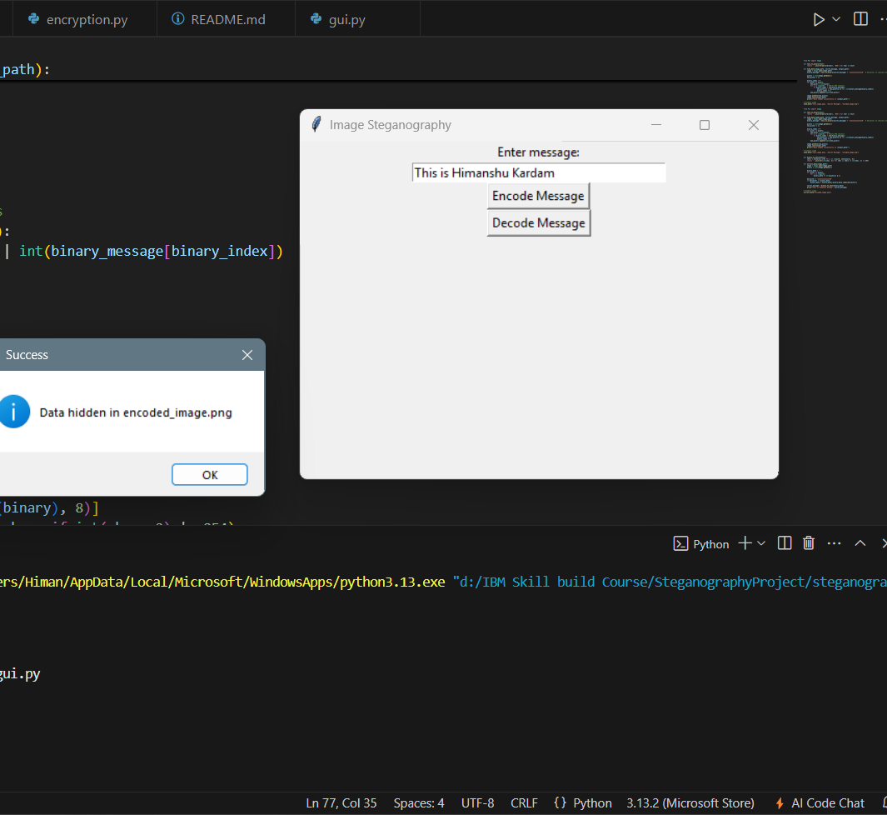
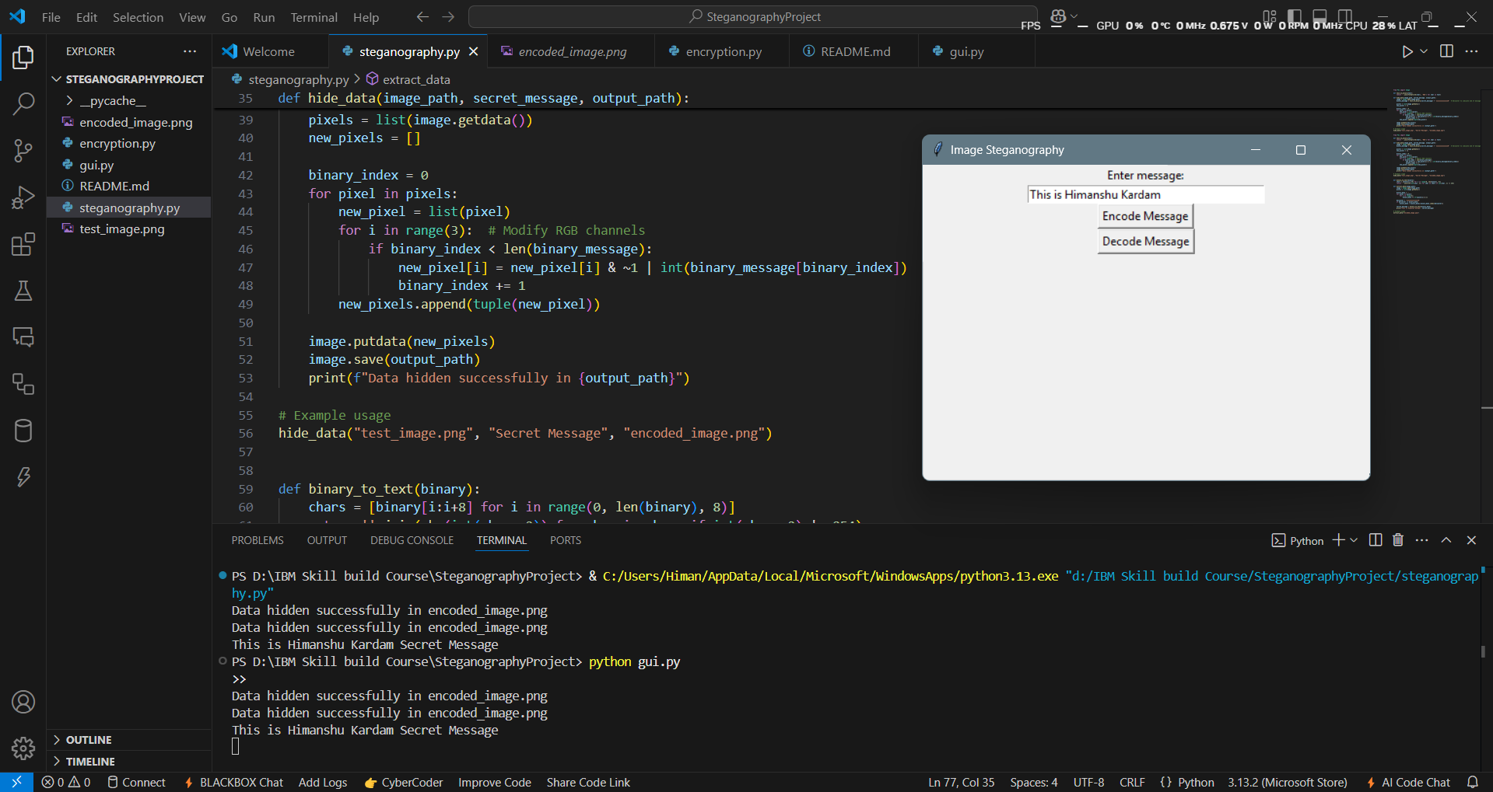
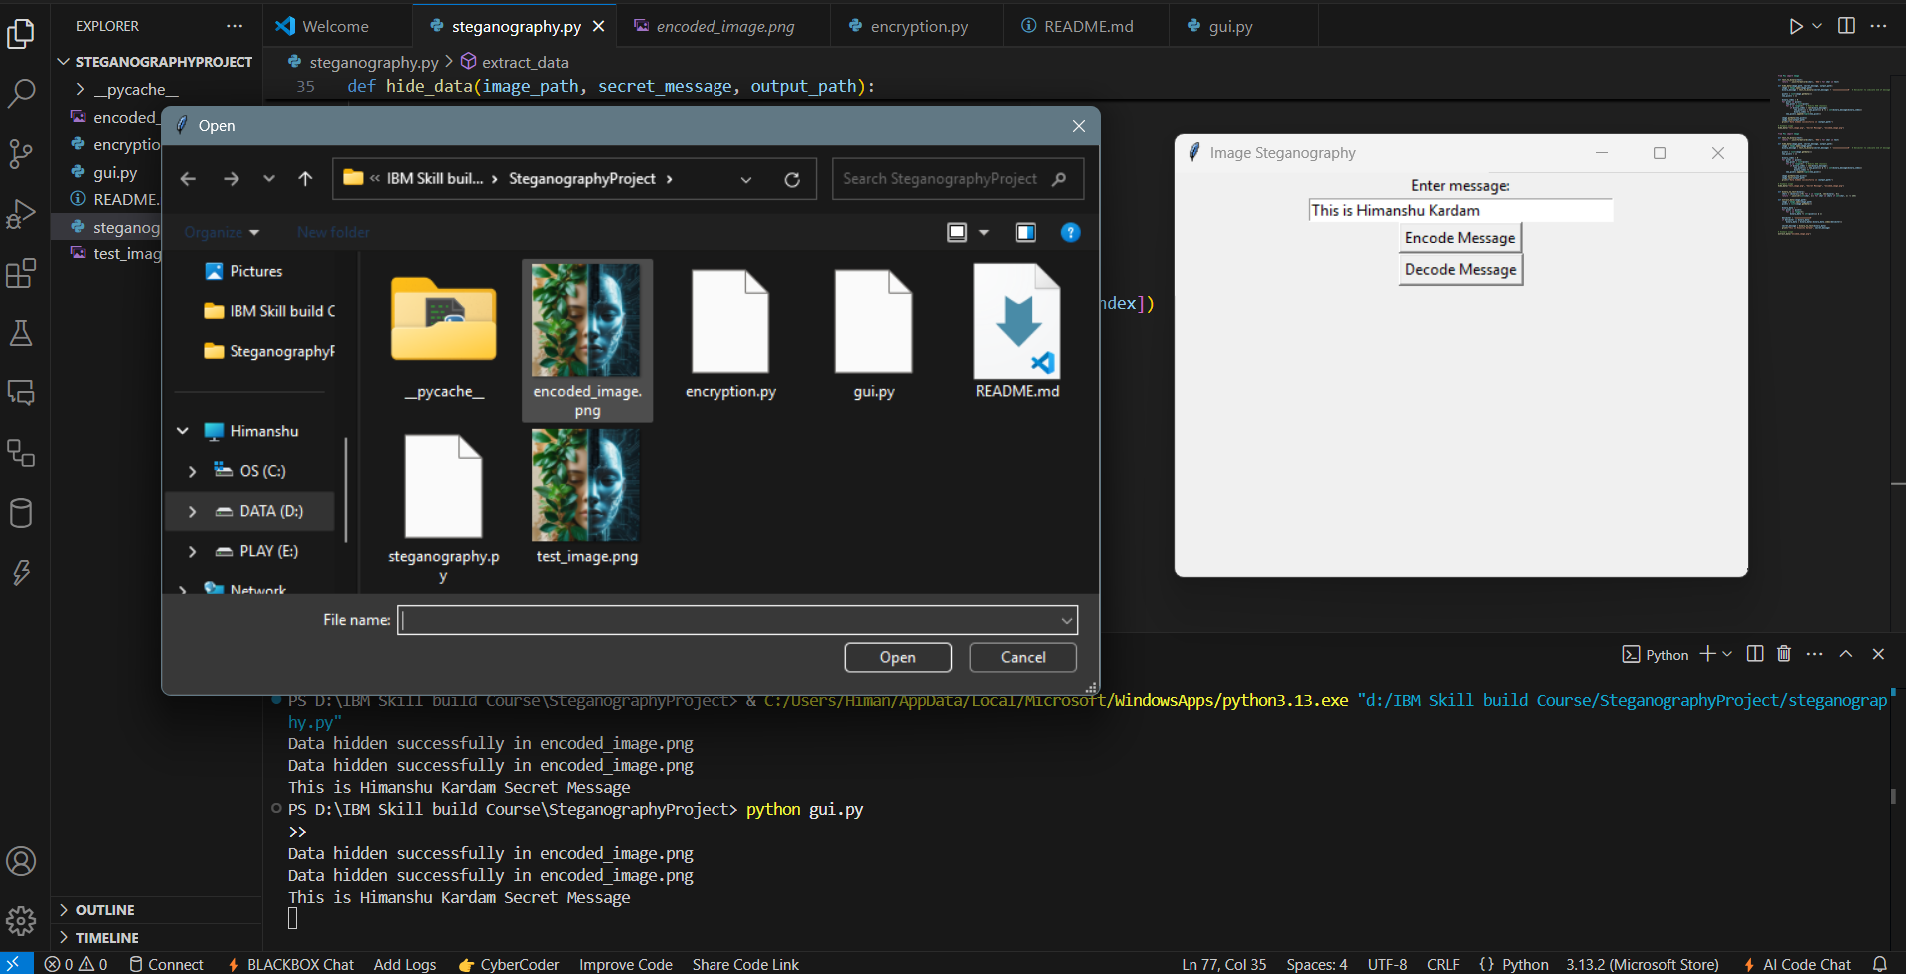
Results

Slide 8
Conclusion
Conclude your project concerning your problem statement
This project serves a wide range of users, from cybersecurity professionals to general users concerned with privacy. It is a powerful tool for secure communication, digital security, and data protection.

Slide 9
GitHub Link
Here’s my GITHUB LINK
https://github.com/xhiamnshux/ImgSteganography

Slide 10
Future scope(optional)

Slide 11
THANK YOU

